Slide 1
Machine Learning
Data Science at Zindua School | By Chris Aloo

Slide 2
Table of Contents
What is Machine Learning
ML Project Workflow
Working with Jupyter Notebooks and Scikit Learn

Slide 3
What is Machine Learning

Slide 4

Definition
Computers detecting Patterns without being explicitly programmed.
Types of Machine Learning
Supervised Learning
Unsupervised Learning
Recommender Systems
Reinforcement Learning

Slide 5
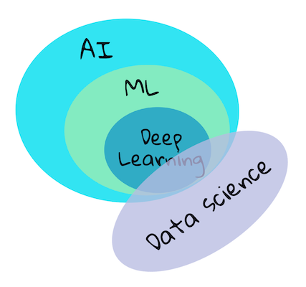
Distiction Between AI, ML, NN, Deep Learning
AI : Simulating human intelligence. It is the superset of ML, NLP, Robotics, General Intelligence and others
ML : Field of AI concerned with developing models based on sample data (Training data) instead of hard coded rules
Deep Learning : DL is a further subset of ML
NN: Neural networks are algorithms that model data using graphs of Artificial Neurons, mathematical models that mimic approximately how a neuron in the brain works
Infographic by Jen Looper inspired by this graphic

Slide 6
Supervised Machine Learning

Slide 7
Supervised Learning
Input Data (X)
Model
Output (y)
Input | Output
transaction behaviour | credit score
email | spam/no spam
audio | transcript
Swahili | French
image | tumour/no tumour

Slide 8
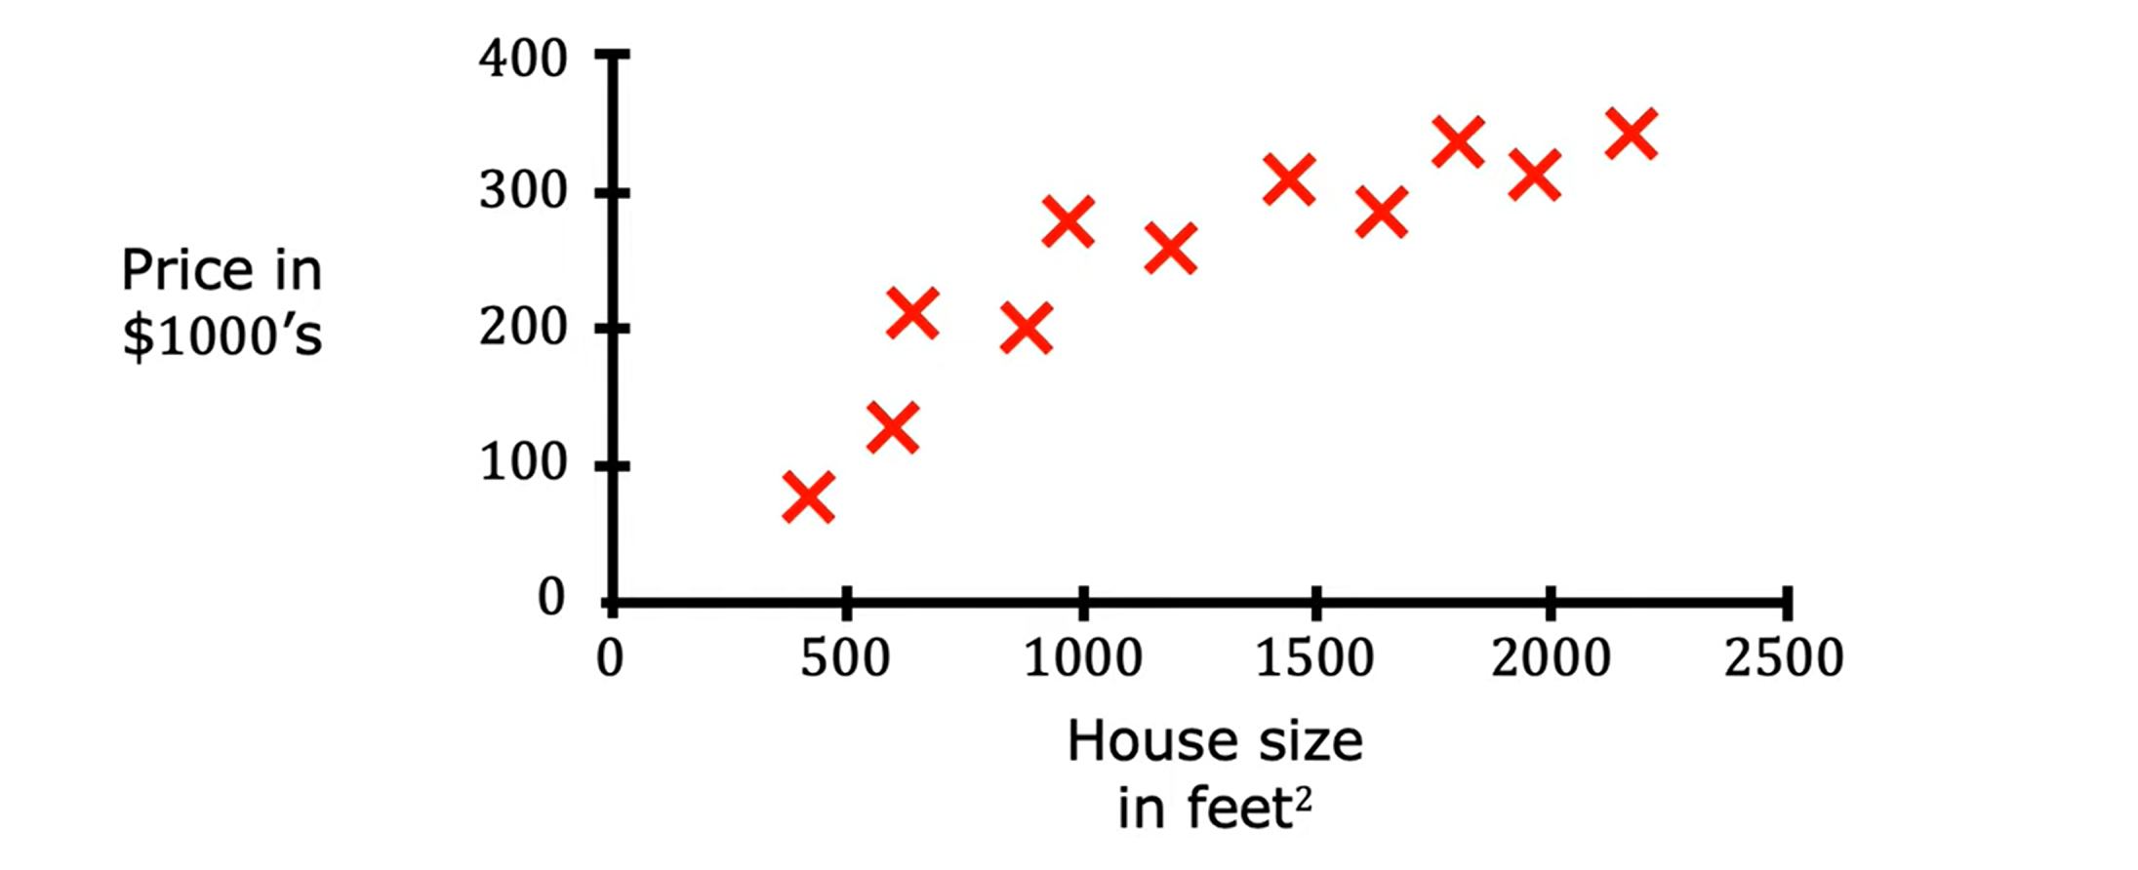
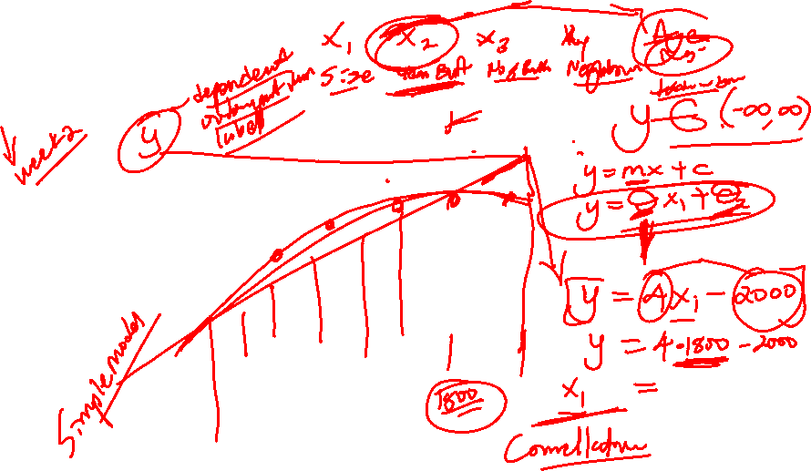
Supervised Learning Regression

Slide 9
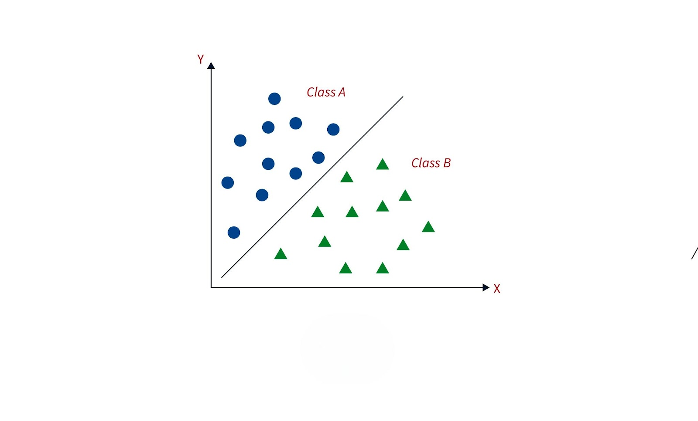
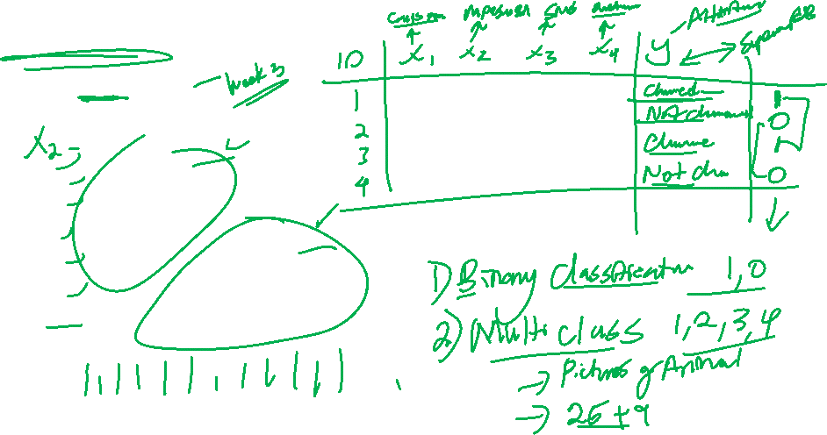
Supervised Learning Classification

Slide 10
Unsupervised Machine Learning

Slide 11
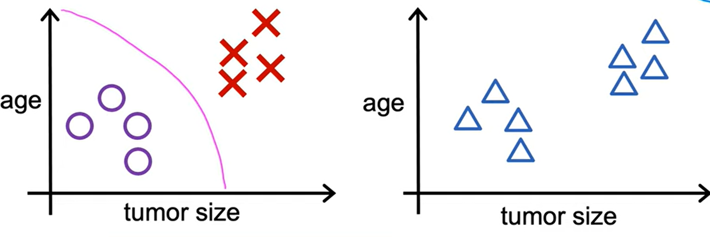
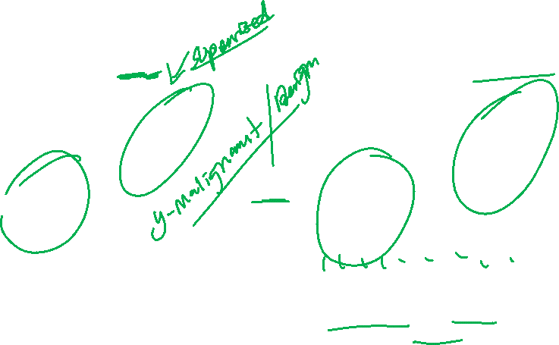
Unsupervised Learning
Data comes with labels y
Data does not come with labels y
Algorithm finds Finding Patterns in the data

Slide 12
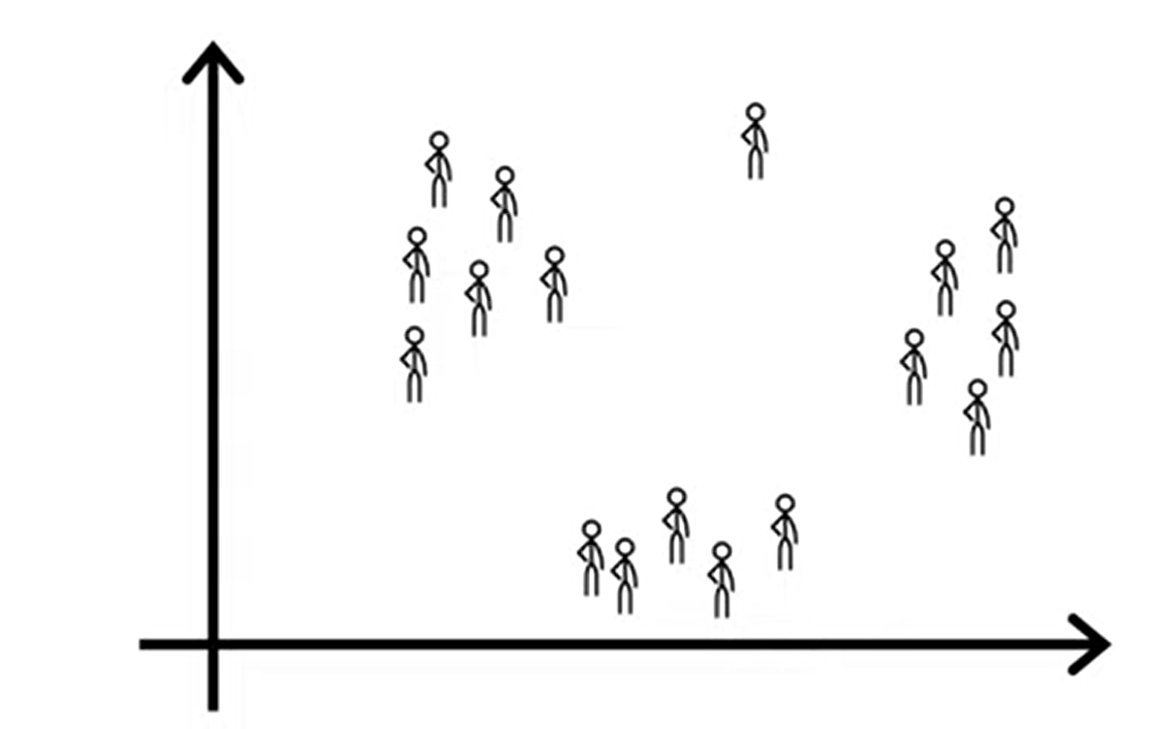
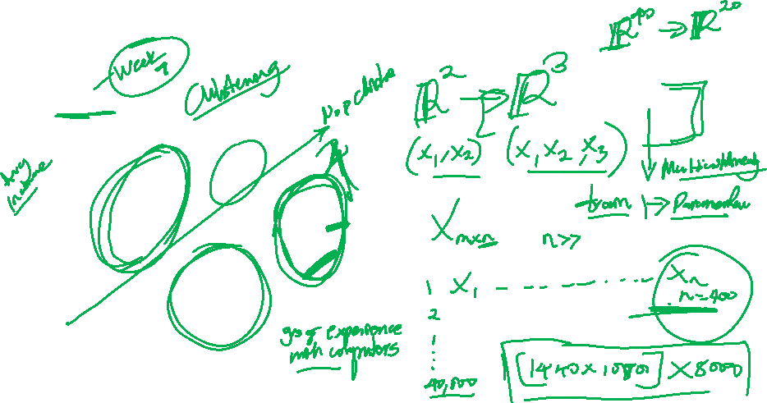
Unsupervised Learning
Clustering : Grouping Similar Data
Dimensionality Reduction Algorithms

Slide 13
ML Project Workflow

Slide 14
The ML Project Lifecycle
Problem Framing
Data Collection
Data Cleaning
EDA
Data Preprocessing/Feature Engineering
Machine Learning Modeling
Model Evaluation & Optimisation : How it generalizes
Deployment and Monitoring

Slide 15
Working with Notebooks

Slide 16
End…

